Slide 1
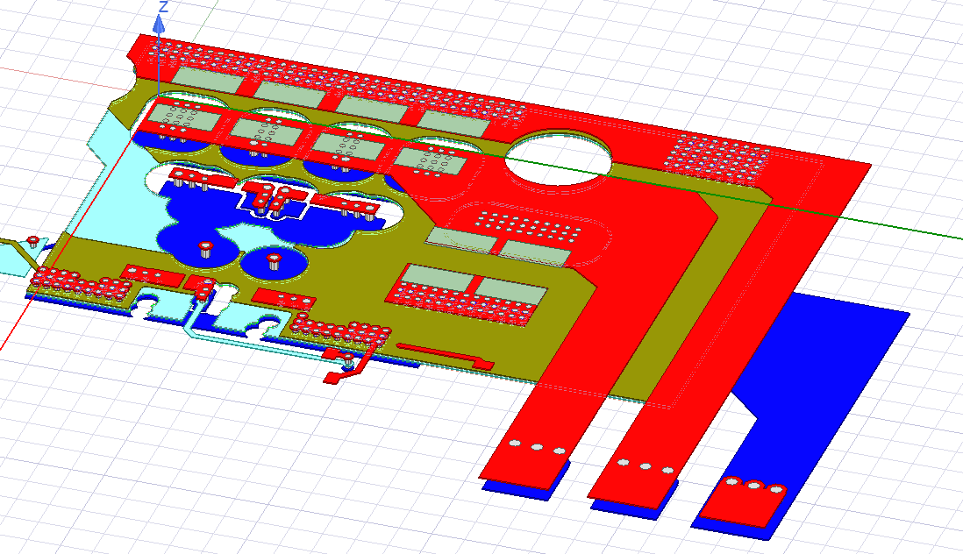
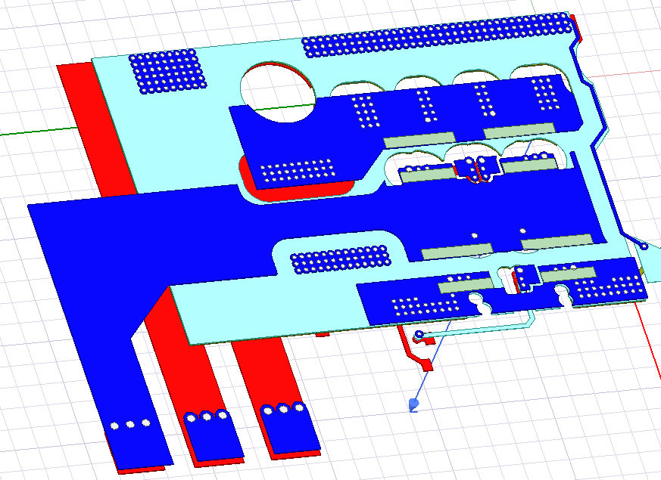
Power Loop Inductance Analysis
6 by-pass capacitors (0.22uF each)
Bottom View
Top View

Slide 2
Power Loop Inductance Analysis
Results
DC Analysis | Inductance | 2.68 nH
 | Resistance | 0.32 mOhm
AC Analysis (200 MHz) | Inductance | 0.84 nH
 | Resistance | 11 mOhm
Valid for switching transitions
Represents Paralleled Transistors
Power Loop inductance would be very different if we operate with single half-bridge

Slide 3
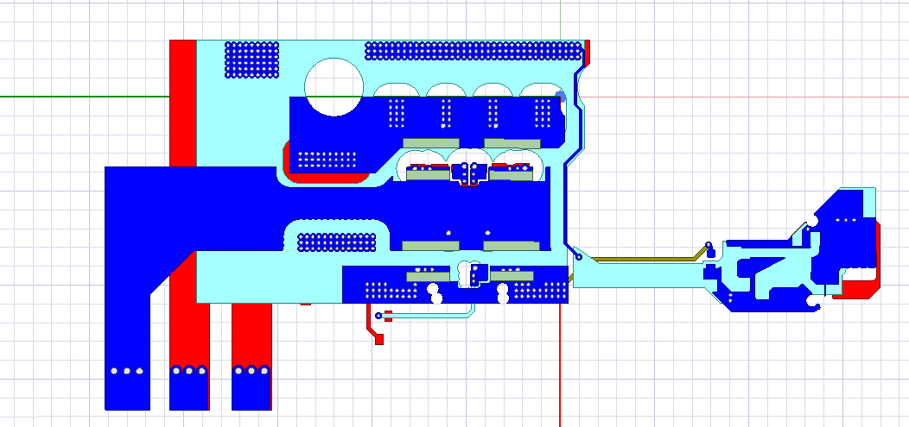
Power Loop Inductance Analysis
Left HB Results
DC Analysis | Inductance | 3.04 nH
 | Resistance | 0.44 mOhm
AC Analysis (200 MHz) | Inductance | 1.16 nH
 | Resistance | 13.6 mOhm
Right HB Results
DC Analysis | Inductance | 5.78 nH
 | Resistance | 0.88 mOhm
AC Analysis (200 MHz) | Inductance | 1.93 nH
 | Resistance | 22 mOhm
Left
Right

